Slide 1
Intro to Stock Analysis
Analyze, visualize data and risk assessment taking
Boming Lu

Slide 2
Tools we need
Moments
Overview
Result & Summary
The Big Picture
Moving Average

Slide 3
The Big Picture
Objective:
Perform risk analysis
Offer investment suggestion
Techniques Needed:
Handy Tools: Google Colab, Matplotlib and Pandas
Essential Knowledge: Moments, Moving Average, Return Deviation
Analysis on Data
+
Risk Analysis & Investment Suggestion
Google Colab and Python frameworks
Stock Data & Statistical Knowledge

Slide 4
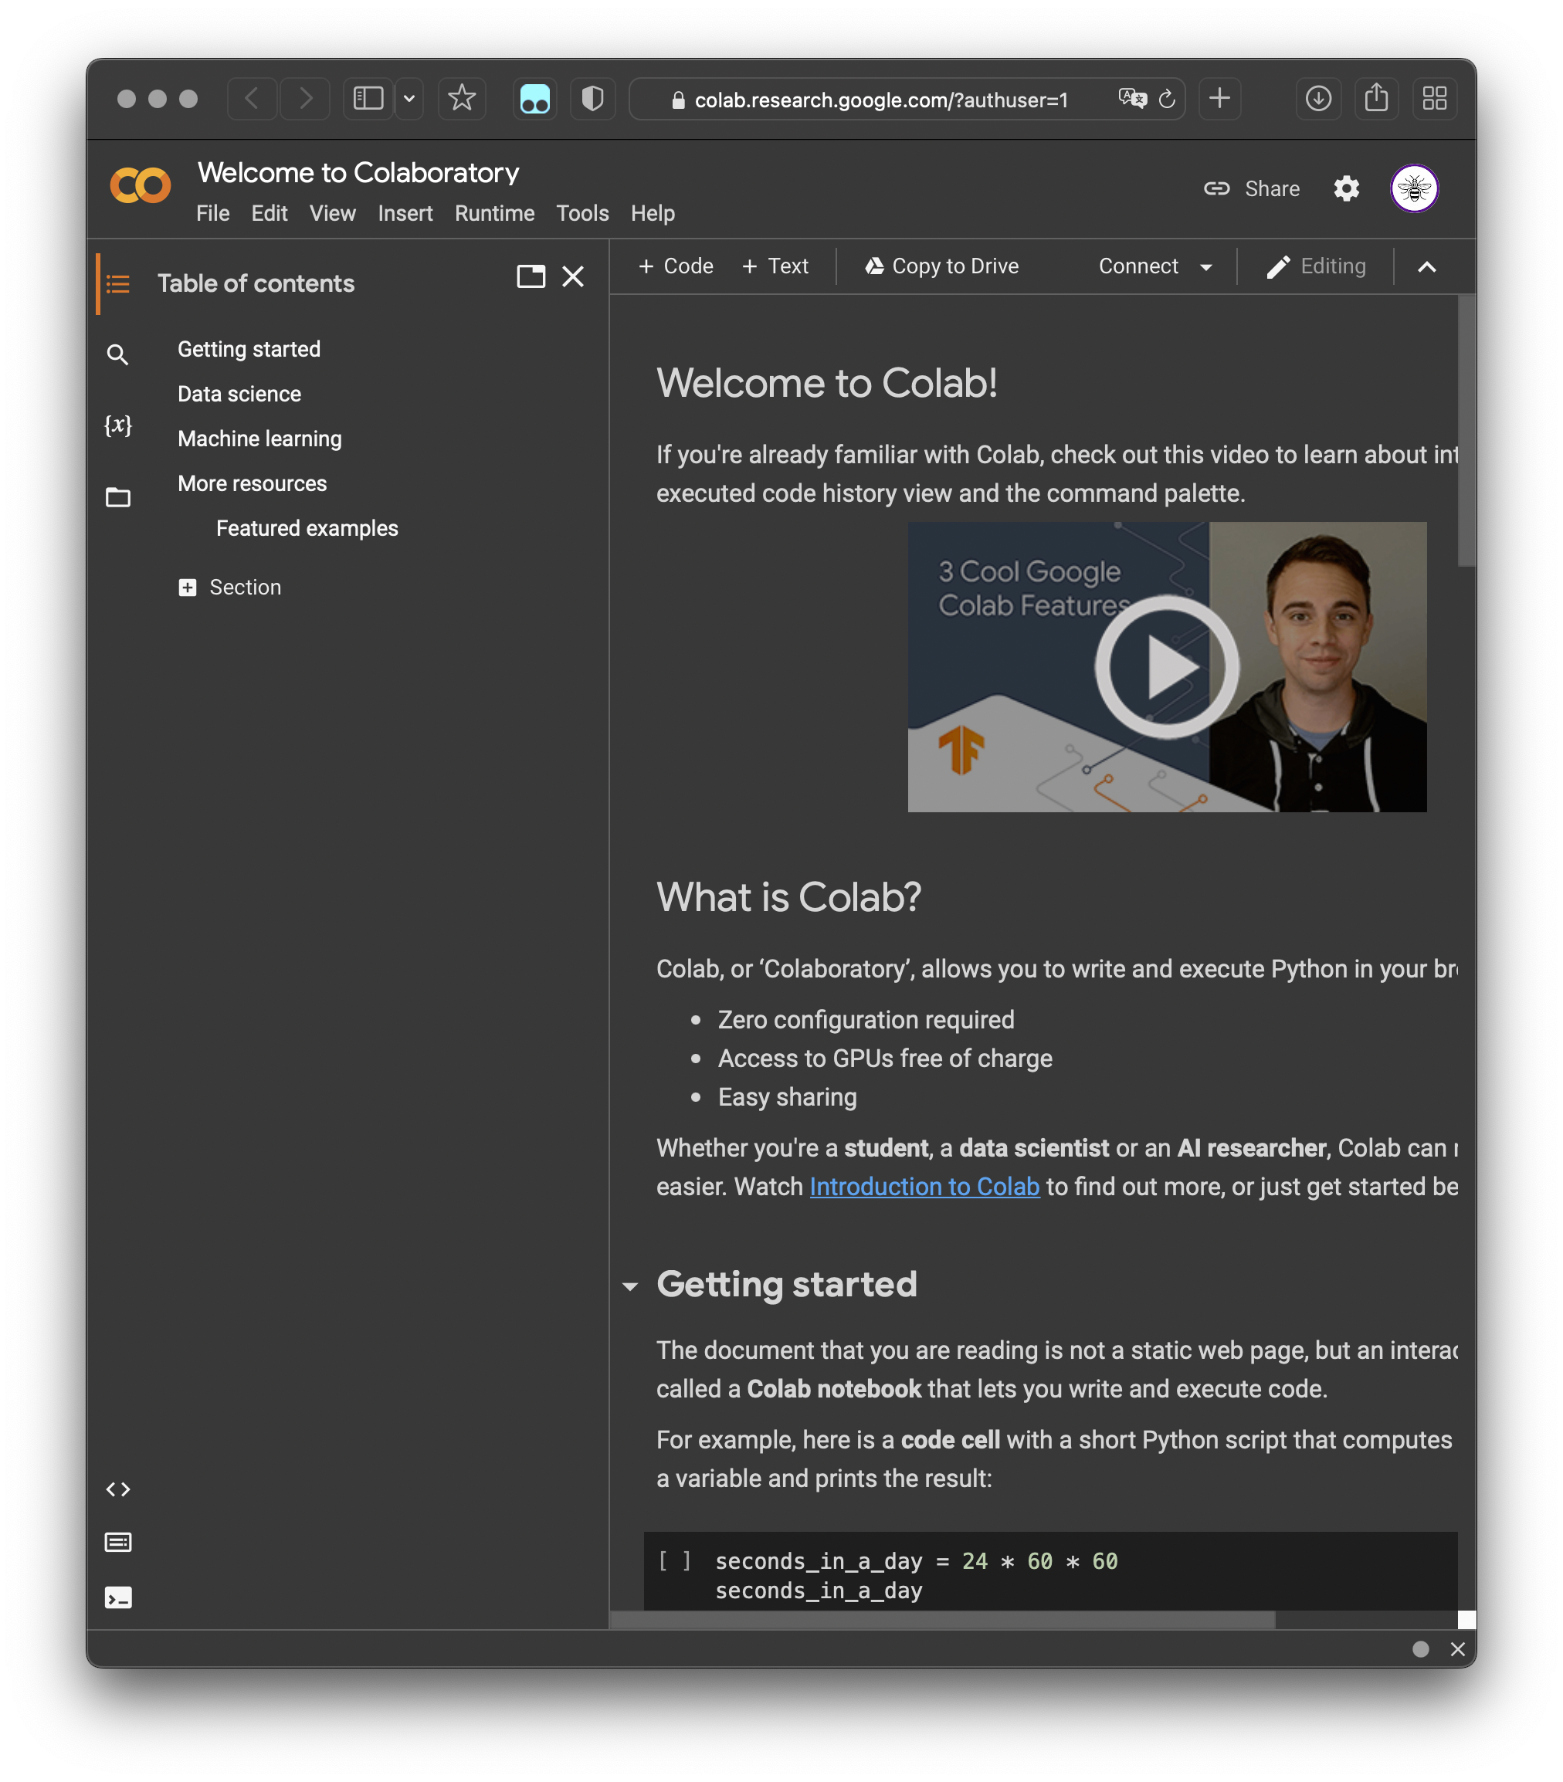
Tools we need: Google Colab
How could we set up?
Preparing environment by yourself?
Why not let others do it for you?
Let’s use Google Colab !
Notebook Editor
File Viewer
Notes:
Briefly introduce google colab: what it is, how to access it (through the link you give them), how does it look like,…

Slide 5
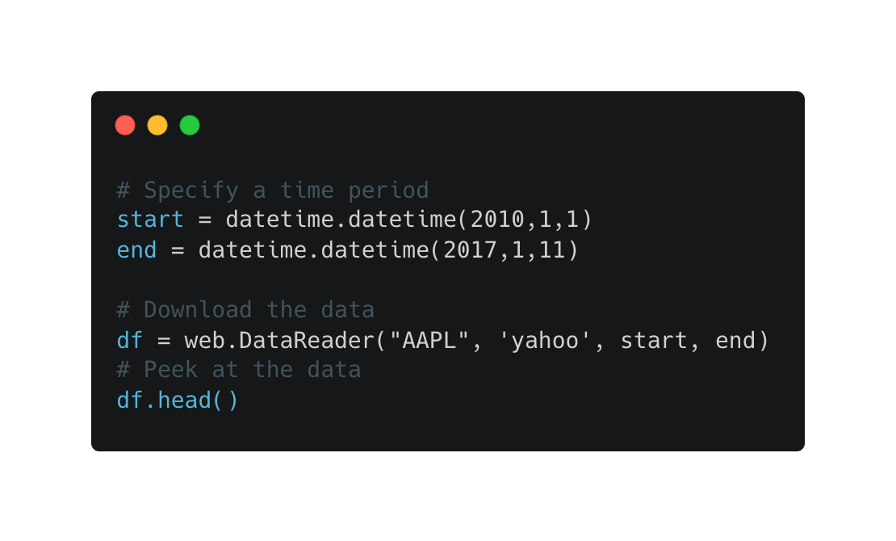
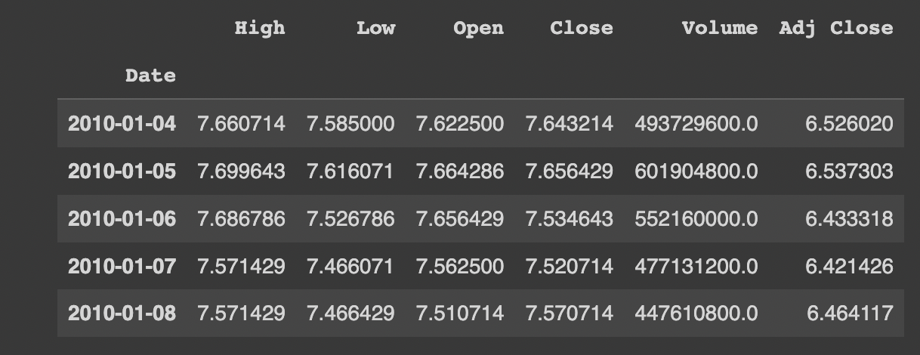
Tools we need: Pandas
Problem: How to manipulate the data?
By hand? Use Pandas!
Things we need:
Downloading the data
Visualizing the data
Getting its statistical knowledge

Slide 6
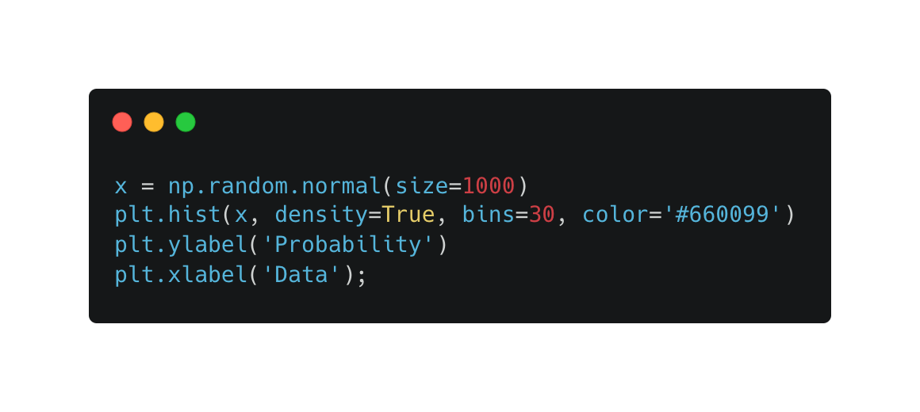
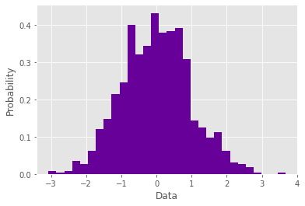
Tools we need: Matplotlib
Problem: How to visualize the data?
Make use of Matplotlib
Things we need:
Plot Histogram
Plot Line charts
Plot Multiple lines

Slide 7
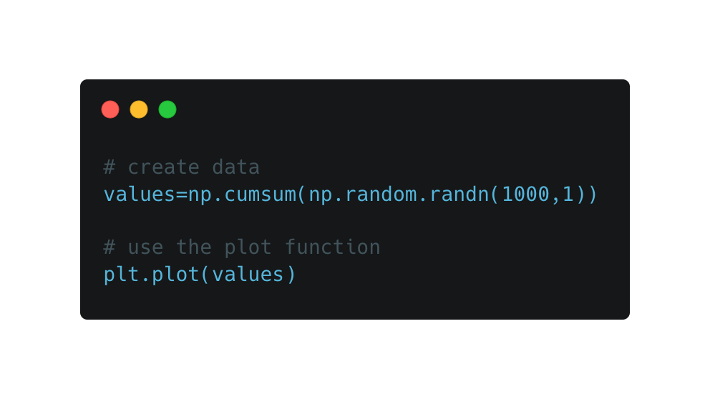
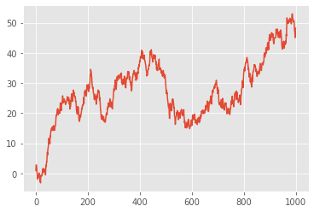
Tools we need: Matplotlib
Problem: How to visualize the data?
Make use of Matplotlib
Things we need:
Plot Histogram
Plot Line charts
Plot Multiple lines

Slide 8
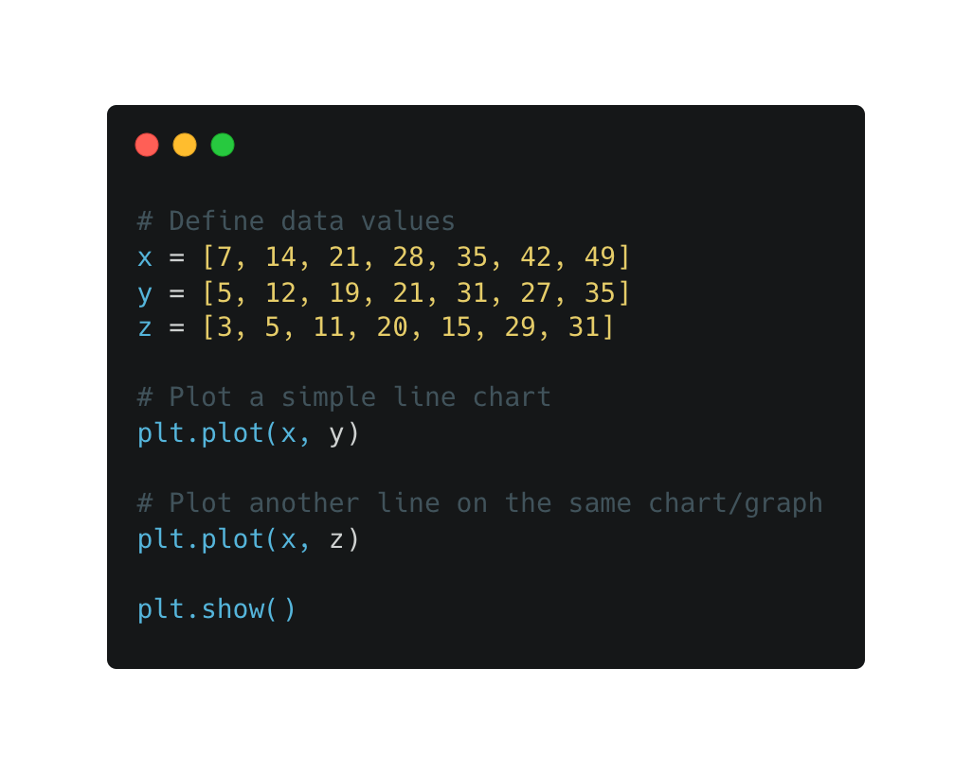
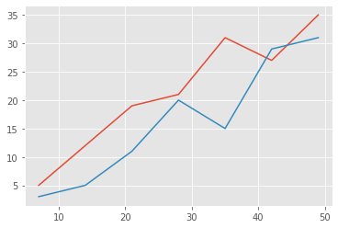
Tools we need: Matplotlib
Problem: How to visualize the data?
Make use of Matplotlib
Things we need:
Plot Histogram
Plot Line charts
Plot Multiple lines

Slide 9
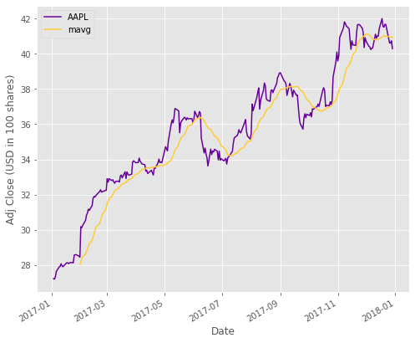
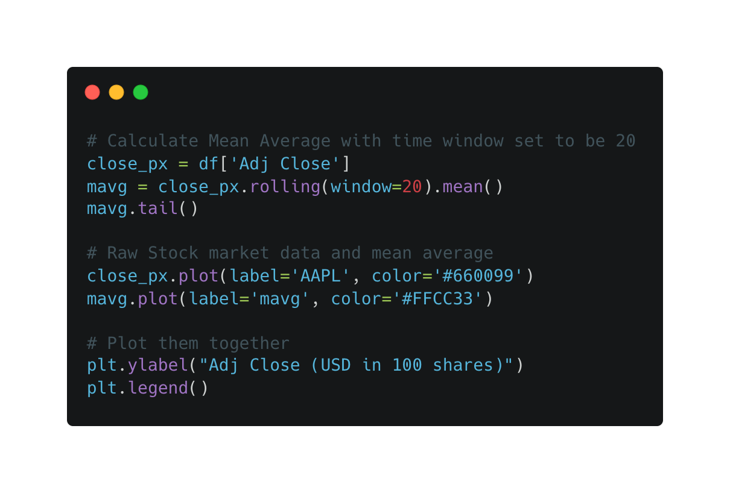
Statistics: Moving Average
Time window: 20 days
Aim: exclude impacts of random, short-term fluctuations
Method: Take arithmetic mean over several days in the past

Slide 10
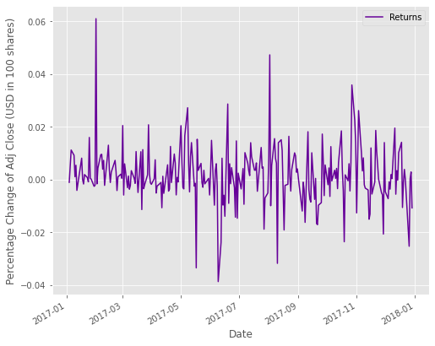
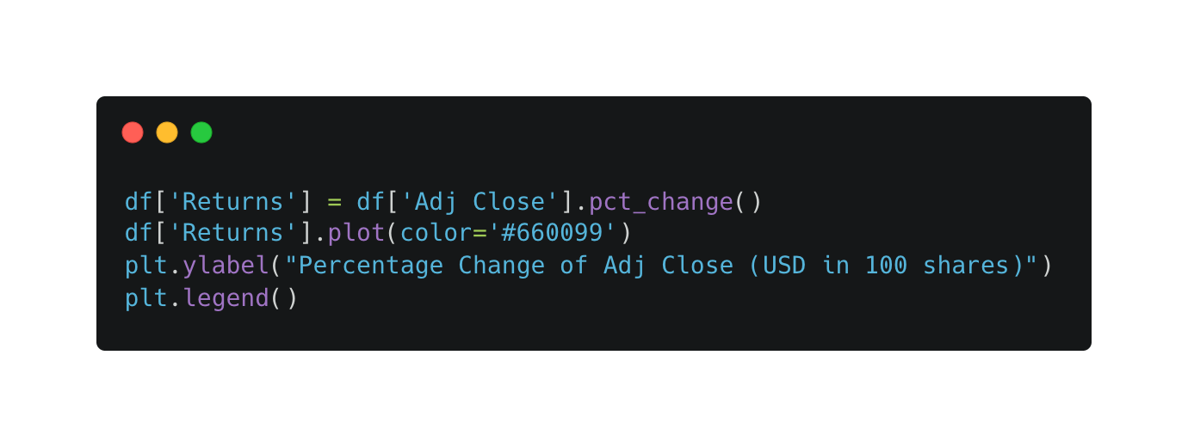
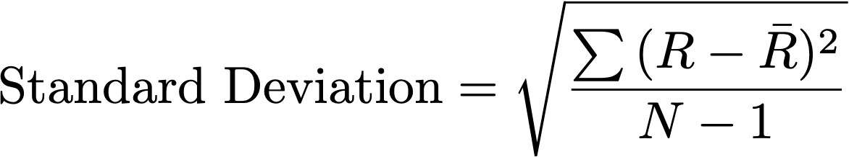
Statistics: Return Deviation
Noticeable Volatility!
Aim: Visualize the risk or volatility in investment
Method: Compare the percentage change with previous days
Notes:
The higher the Standard Deviation, the higher will be the ups and downs in the returns.
To calculate the norm of the returns to get the information about how dispersed the returns are, the SD is calculated as the square root of the variance of the returns. This shows the average return by which the returns over a particular period deviate from the average return.
The higher the value of the standard deviation of returns, the higher will be the volatility of returns. High volatility means that high risk was apparent during the investment period.
https://www.tutorialspoint.com/what-is-standard-deviation-of-return

Slide 11
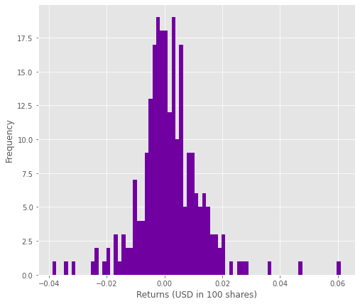
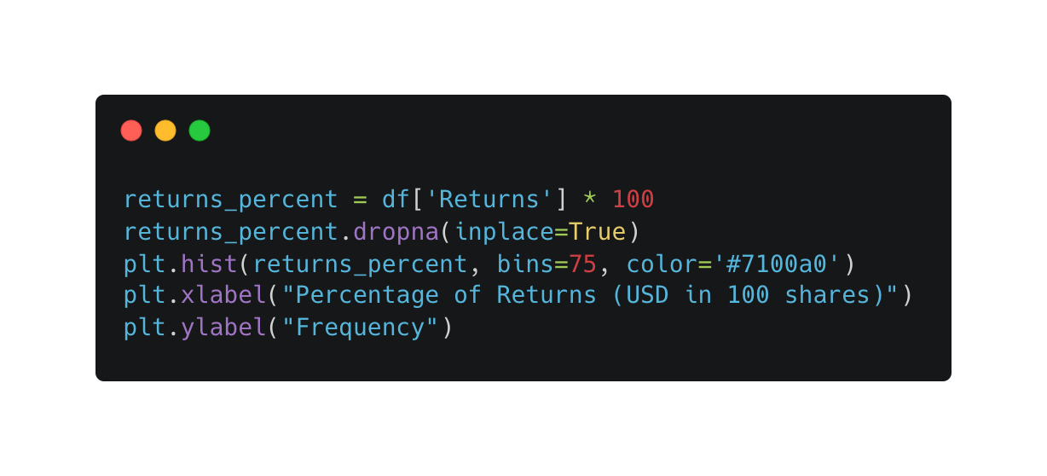
Statistics: Return Histogram
Aim: Visualize the most common return in a series of time
Method: Count each fluctuate rate’s occurrence and plot its histogram
Notes:
The higher the Standard Deviation, the higher will be the ups and downs in the returns.
To calculate the norm of the returns to get the information about how dispersed the returns are, the SD is calculated as the square root of the variance of the returns. This shows the average return by which the returns over a particular period deviate from the average return.
The higher the value of the standard deviation of returns, the higher will be the volatility of returns. High volatility means that high risk was apparent during the investment period.
https://www.tutorialspoint.com/what-is-standard-deviation-of-return

Slide 12
Statistics: Moments
Aim:
Calculate expected return
Measure the investment risk
Measure the skewness
Measure:
Calculate First, Second and Third Moment respectively
Moments in Statistics:
First Moment:
- Measure of central location (Mean)
Second Moment:
- Measure of dispersion (Variance)
Third Moment:
- Measure of asymmetry (Skewness)
Notes:
http://rovdownloads.com/attachments/newsletters/Newsletter%2003%20-%20Understanding%20the%20Forecast%20Statistics%20and%20Four%20Moments%20(4P).pdf
http://rovdownloads.com/blog/understanding-the-forecast-statistics-and-four-moments-3/

Slide 13

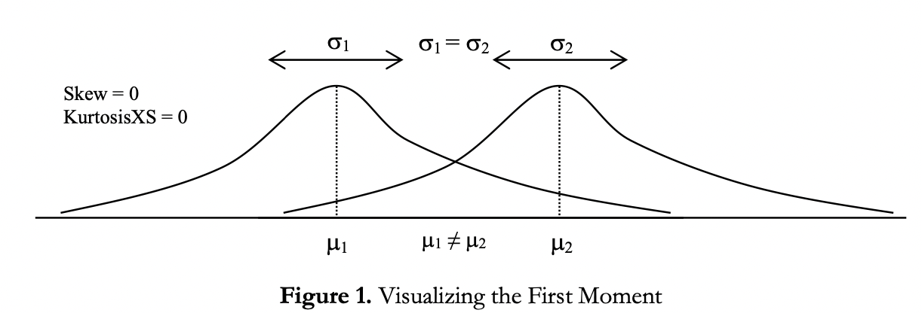
Statistics: First Moment
Aim:
Calculate expected return
Notes:
http://rovdownloads.com/attachments/newsletters/Newsletter%2003%20-%20Understanding%20the%20Forecast%20Statistics%20and%20Four%20Moments%20(4P).pdf
http://rovdownloads.com/blog/understanding-the-forecast-statistics-and-four-moments-3/

Slide 14
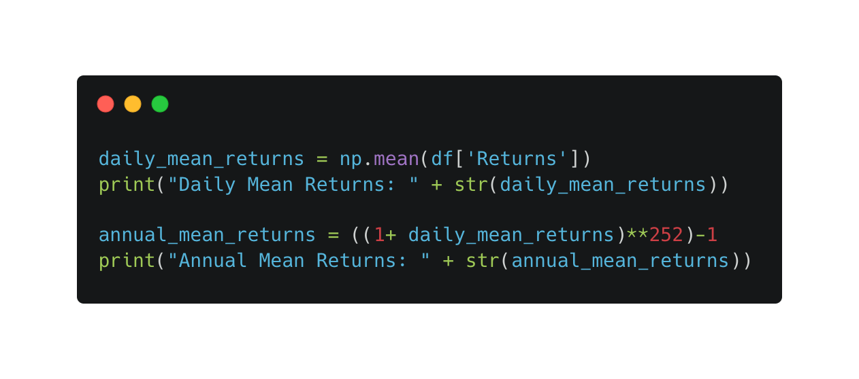
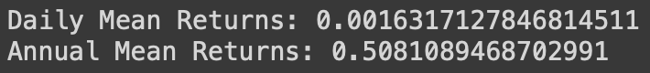
Calculating First Moment
Larger is better!

Slide 15
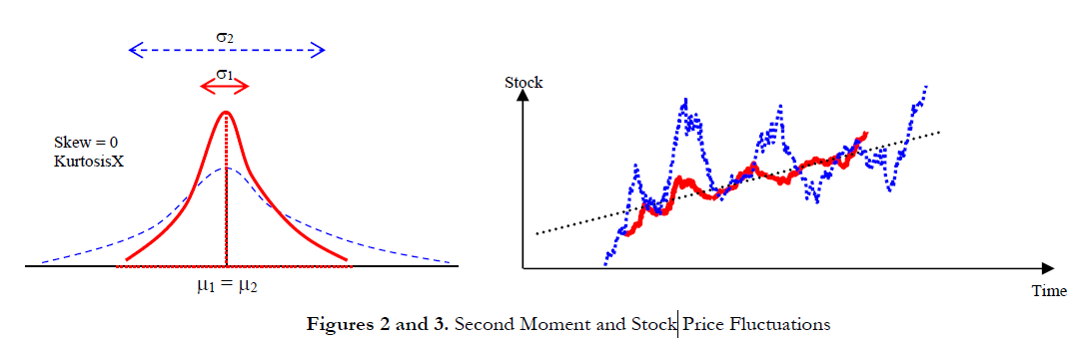

Statistics: Second Moment
Aim:
Measure the investment risk
Notes:
http://rovdownloads.com/attachments/newsletters/Newsletter%2003%20-%20Understanding%20the%20Forecast%20Statistics%20and%20Four%20Moments%20(4P).pdf
http://rovdownloads.com/blog/understanding-the-forecast-statistics-and-four-moments-3/

Slide 16
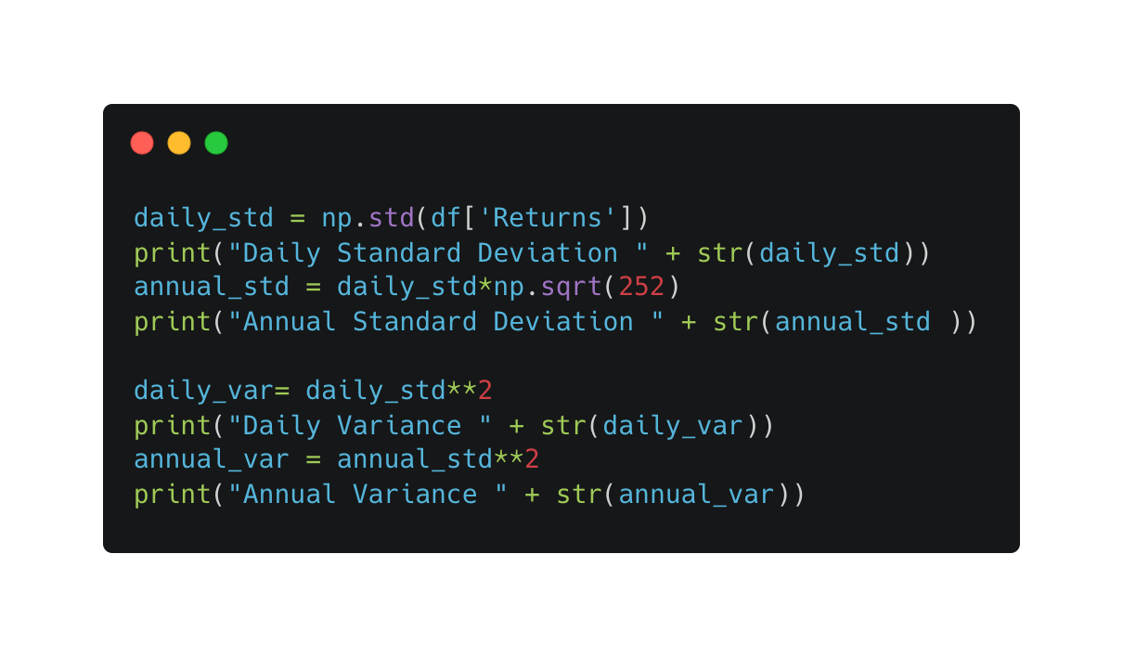
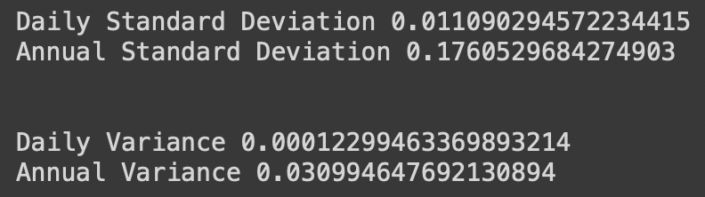
Calculating Second Moment
Smaller is better!

Slide 17
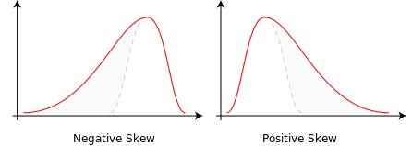
Statistics: Third Moment
Aim:
Measure the skewness
Notes:
http://rovdownloads.com/attachments/newsletters/Newsletter%2003%20-%20Understanding%20the%20Forecast%20Statistics%20and%20Four%20Moments%20(4P).pdf
http://rovdownloads.com/blog/understanding-the-forecast-statistics-and-four-moments-3/

Slide 18
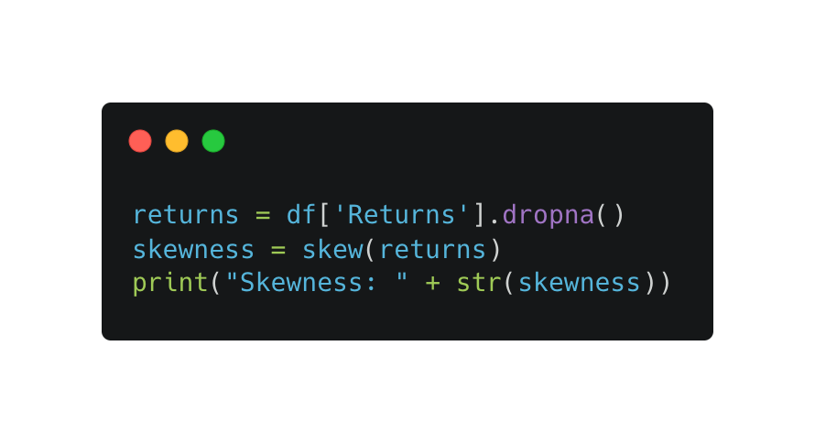
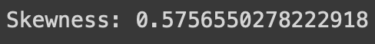
Calculating Second Moment
We want positive skew!
Bigger is better

Slide 19
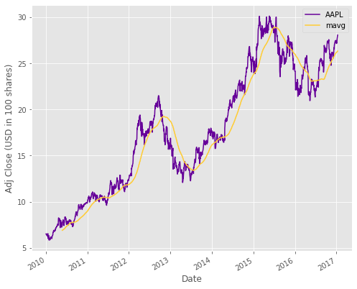
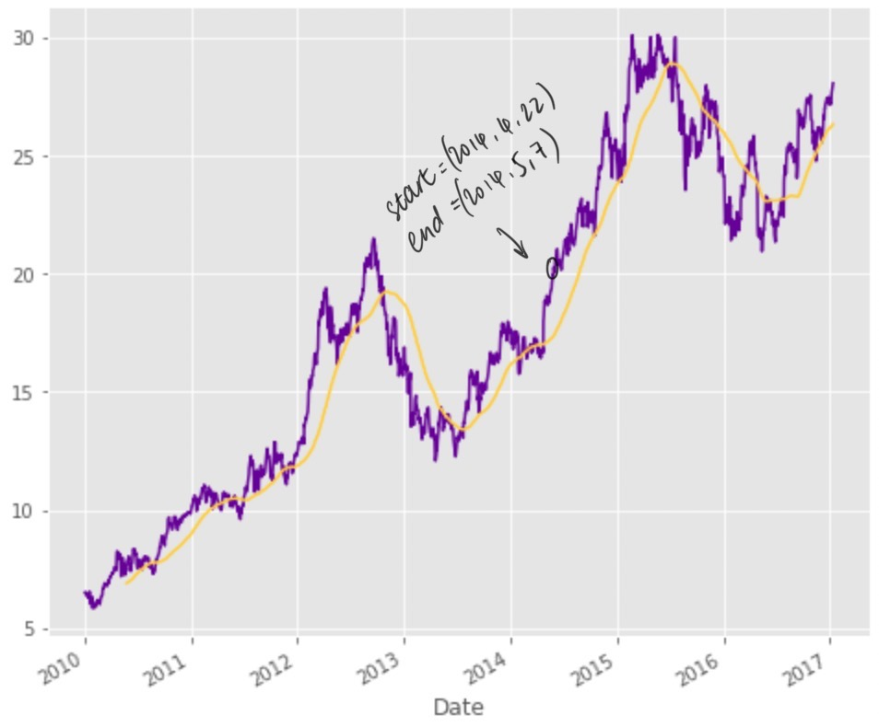

Slide 20
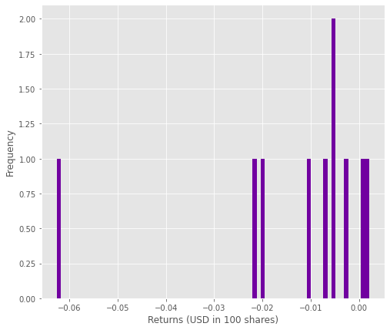
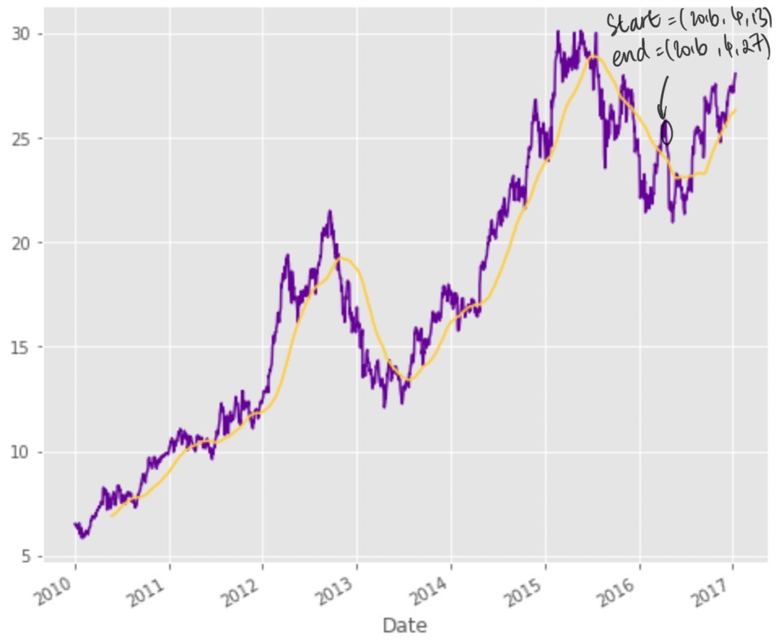
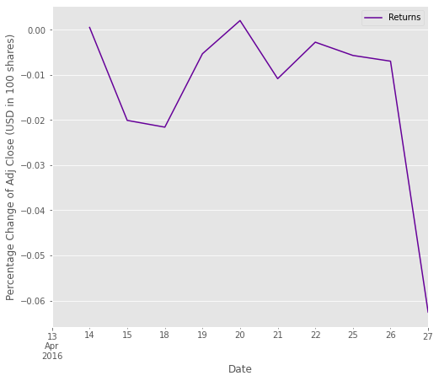
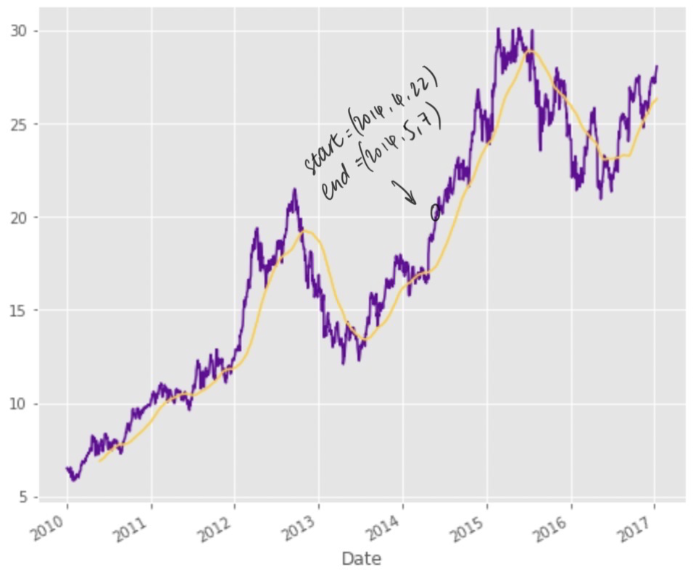
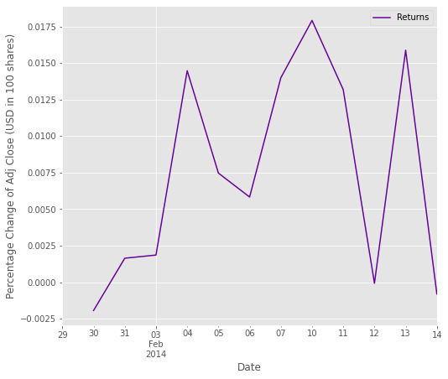
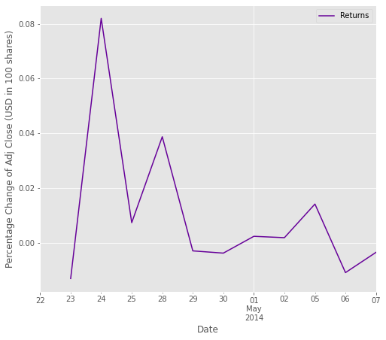
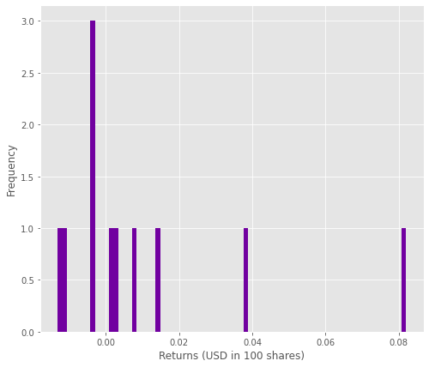
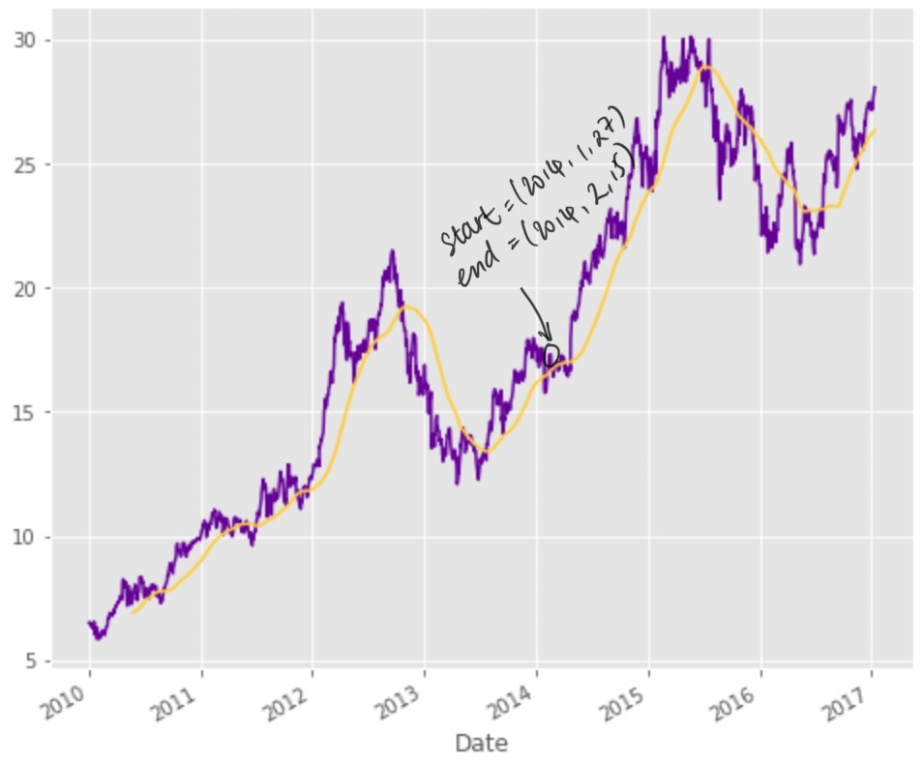
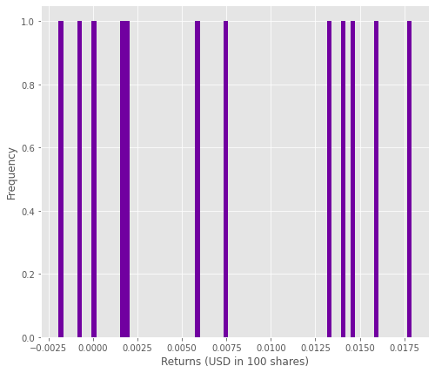
Type | Time range | Return deviation | Histogram | 1st moment (annual mean retunrs) | 2nd moment (annual variance) | 3rd moment ( skewness)
Increasing
Decreasing
Relatively stable
11.9
(3 s.f.)
0.176
(3 s.f.)
1.79
(3 s.f.)
-0.965
(3 s.f.)
0.0819
(3 s.f.)
-1.91
(3 s.f.)
5.49
(3 s.f.)
0.0123
(3 s.f.)
0.0893
(3 s.f.)

Slide 21
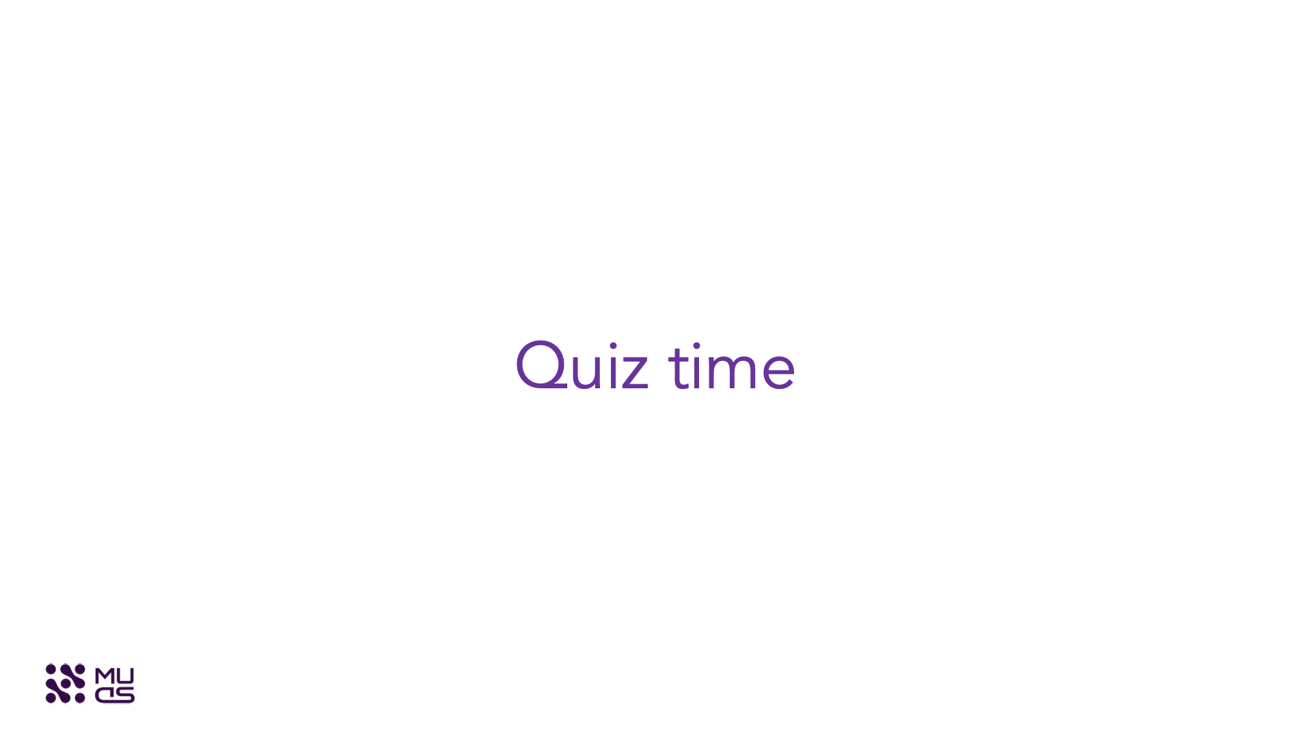
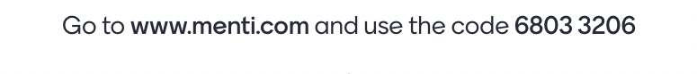

Slide 22

Code Stub for Lab
shorturl.at/DIJZ5

Slide 23
Thanks

